Slide 1



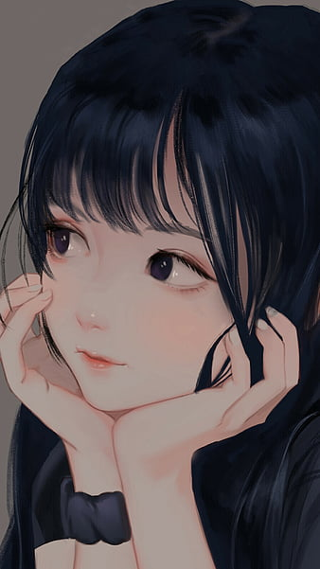

Hello Everyone
MY SELF PRESENTATION
Prepared by: Amna

Slide 2

ABOUT ME
My name is Amna. I am a 2nd year Commerce student from Karachi. I am a motivated and positive-minded person with a strong interest in teaching and learning new skills.

Slide 3

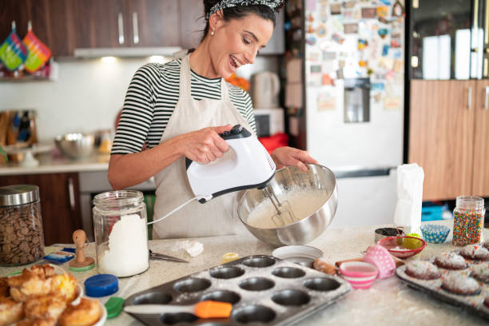


HOBBIES AND INTERESTS
Reading story books 📚 – Stories inspire my imagination.
Baking 🍰 – I enjoy making sweet dishes in my free time.
Business strategies & calculations ➗ – I like solving problems and exploring accounting concepts.

Slide 4

ACHIEVEMENTS AND SKILLS
Completed Matriculation and currently studying Intermediate along with Darse Nizami
Improved English speaking skills
Through this CIT course, I have learned
MS Word: Document creation & formatting
MS PowerPoint: Designing presentations
MS Excel: Basic data management

Slide 5
STRENGTHS
WEAKNESSES
Quick learner – I understand and remember things fast
Sharp memory – I retain knowledge for a long time
Helpful nature – I like supporting others
Short tempered in some situations
Low confidence when talking to new people

Slide 6

ROLE MODEL
My biggest inspiration and role models are my parents. They always support me, guide me in every decision, and encourage me to study hard and stay positive. Their hard work, patience, and sacrifices inspire me to follow my dreams and achieve success in life.

Slide 7


